Slide 1
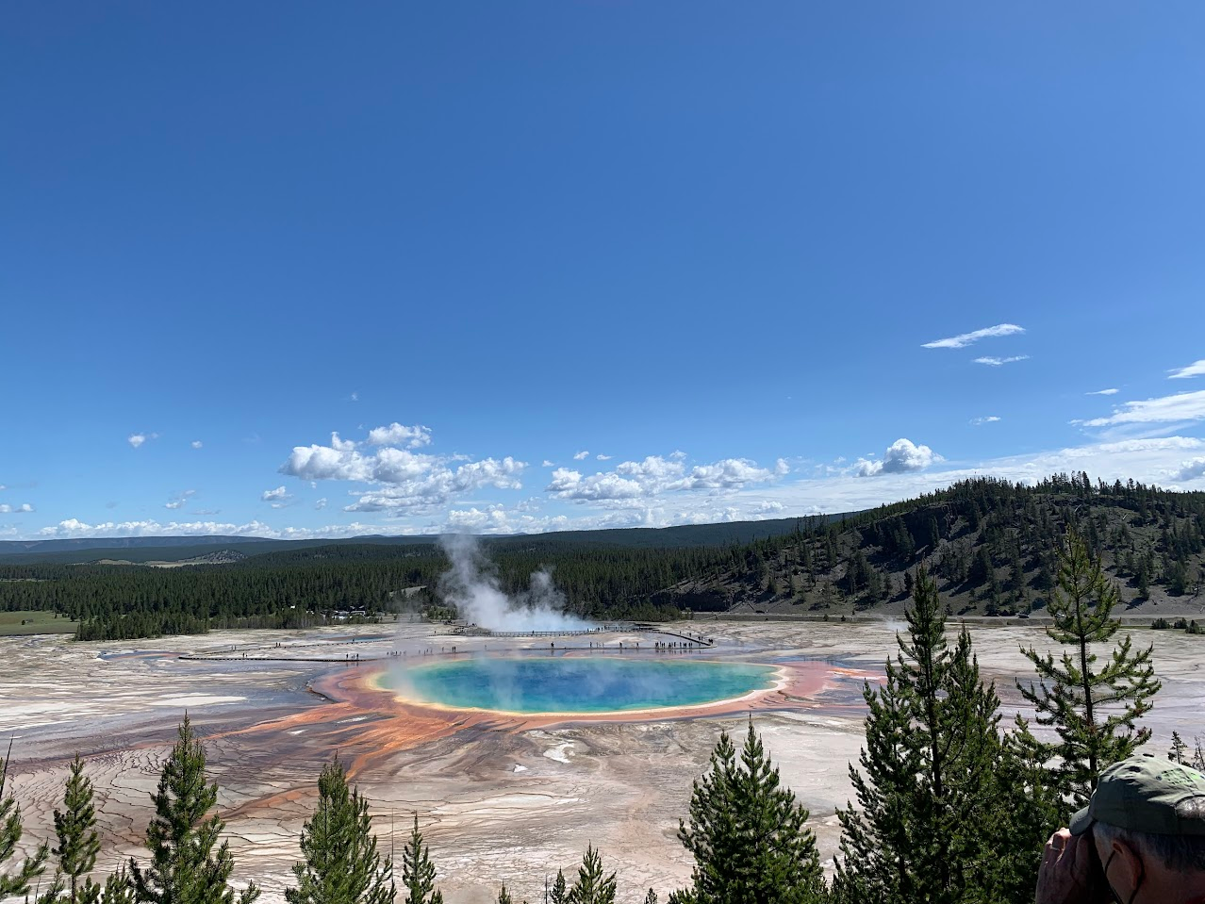



Remote Sensing for Geothermal Area Characterization
Jess Condon
Mentor: Dr. R. Greg Vaughan
Astrogeology Science Center, Flagstaff, AZ
Space Grant Symposium, Tucson, AZ
April 20th, 2024
Picture by Jess Condon

Slide 2
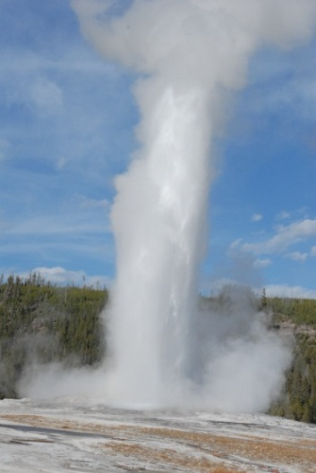
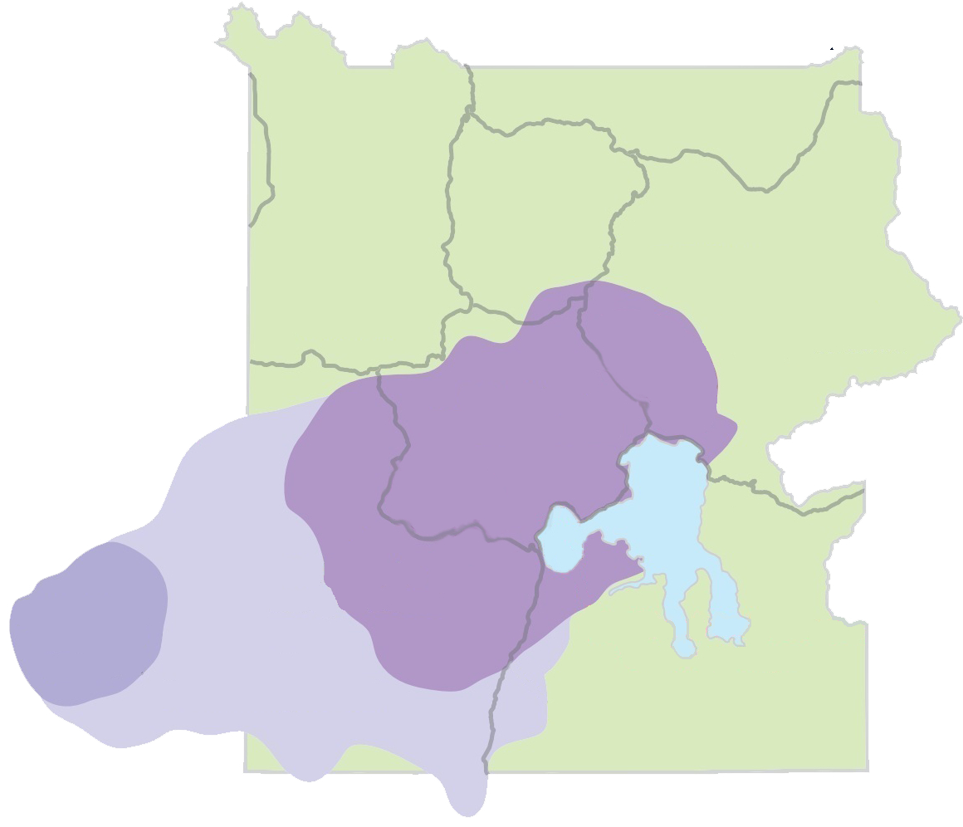
Yellowstone National Park
Located over a dormant volcanic system
History of enormous eruptions
Famous for thermal features: geysers and hot springs
These features are evidence that Yellowstone is still an active region
From YVO Annual Report 2022
From YVO Annual Report 2022
Yellowstone Caldera
Henry’s Fork Caldera
Island Park Caldera
Notes:
There is a large, partially molten, rhyolite magma reservoir at depth (5-10 km) and the heat from this has been driving a very large geothermal system for a long time. There is a considerable heat flux there, which is manifested at the surface as the largest concentration of geothermal features in the world. It’s famous, of course, for its hot springs and geysers. Geysers are just a special type of hot spring where the geometry of the underground plumbing is conducive to intermittent / episodic eruptions of water and steam. There are only about 1000 geysers on Earth – about half of them are in Yellowstone. And all these spectacular thermal features are the main reason this area was set aside as a NP in 1872 (one of the world’s first NPs).

Slide 3
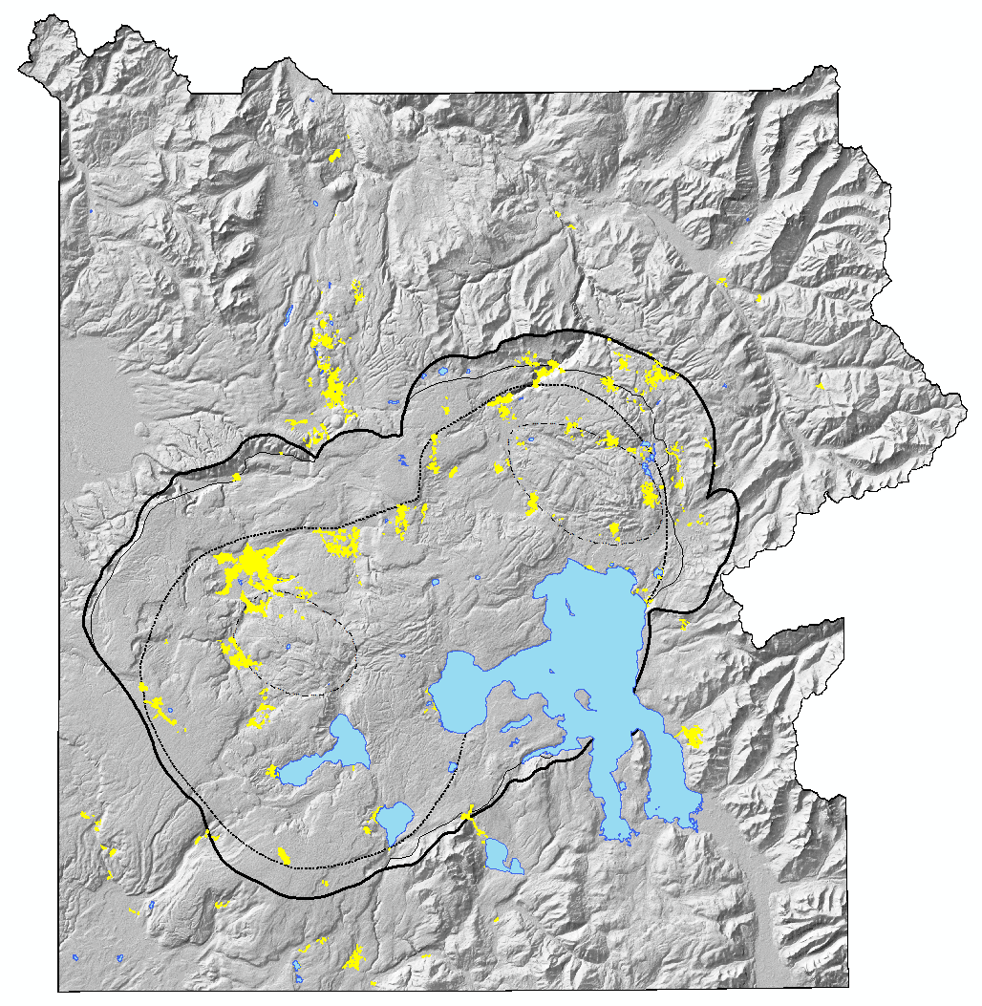
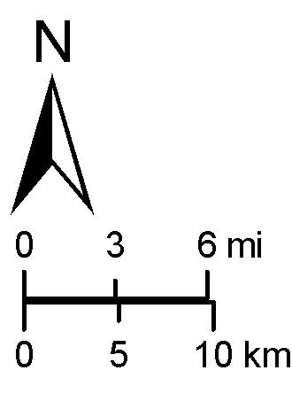
Objectives
Thermal Areas
Measure and monitor changes in the heat output of Yellowstone’s thermal areas
Important to understanding current geothermal activity
Aid in detecting future anomalous activity
Sour Creek Dome
Yellowstone Caldera
Large Lakes
Thermal Areas
Mallard Lake Dome

Slide 4
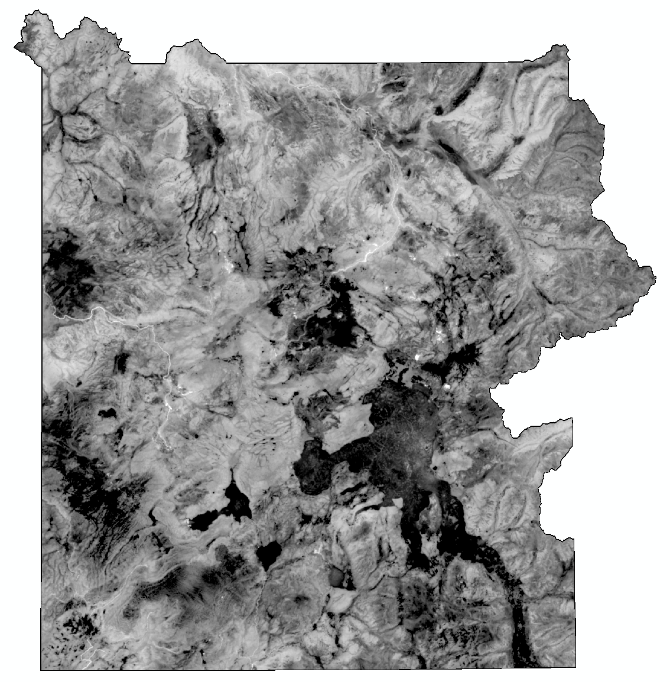
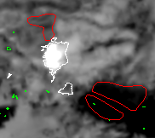
Methods
Landsat 8/9 Thermal Infrared Image
Nighttime thermal infrared data from Landsat 8/9 satellites
Analyzed in ENVI
Data from the thermal areas were compared to data from non-thermal background areas
White: Sulfur Hills Thermal Area
Red: Background Areas
From 2023-12-25 Landsat 9 Image
Notes:
When you are looking at a TIR image, you are looking at a map of how much energy is being radiated from Earth’s surface at TIR wavelengths. You’re not looking at temperature; you’re not measuring temperature; you are measuring Spectral Radiance in W/m²/υm/sr. Temperature is calculated from this by using the Planck equation, solving for temperature. And then, using the Stefan-Boltzmann law, total emitted radiance (in W/m²) is calculated from the temperature data, and then multiplying by pixel area, we get a total radiative power output (in W, or MW).

Slide 5
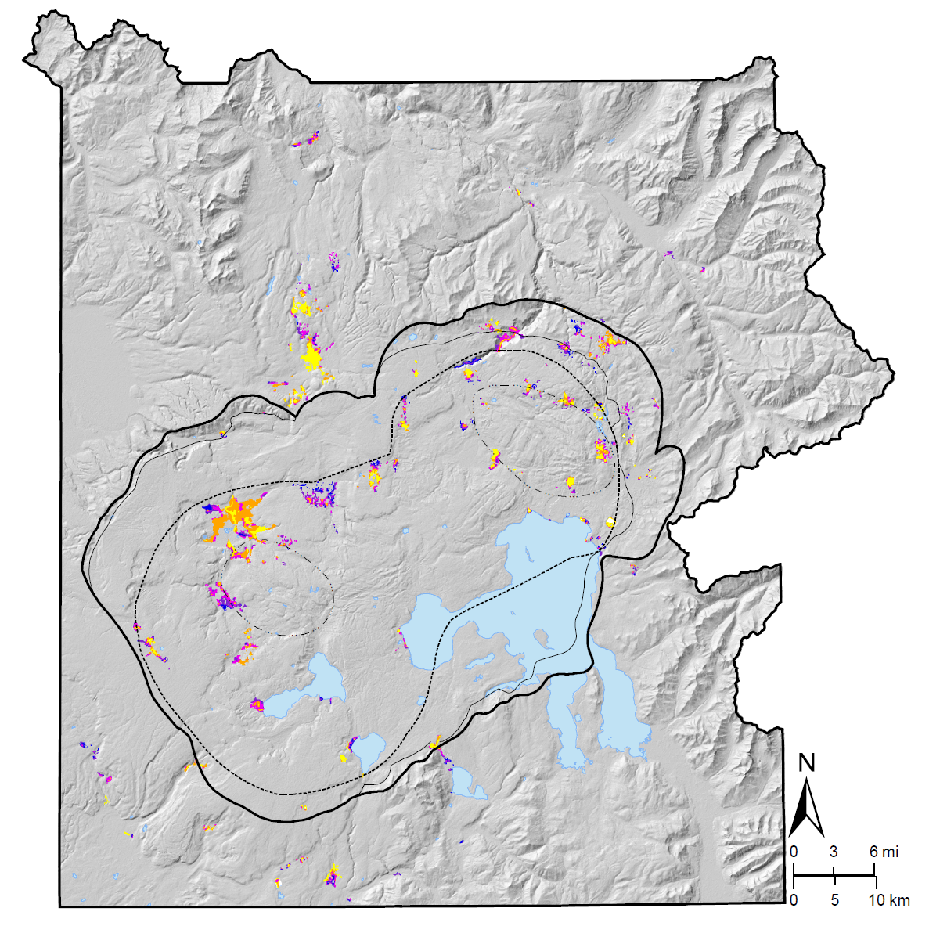
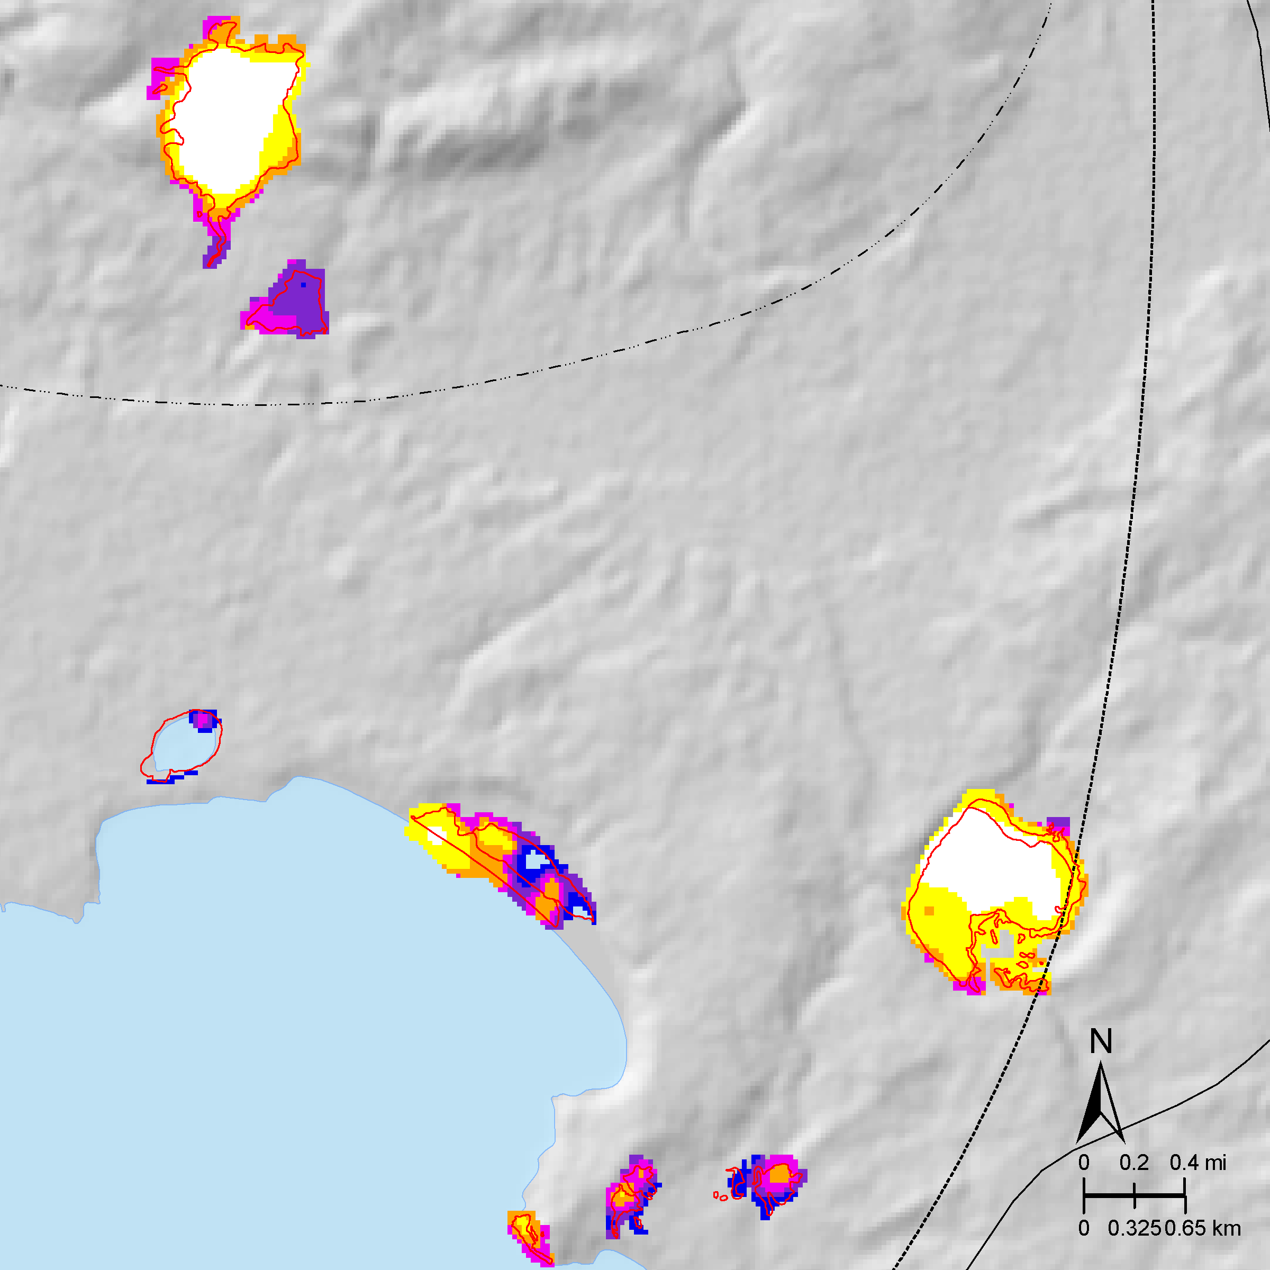
Yellowstone Thermal Anomaly Map – 2021-01-09 nighttime (Landsat 8)
Sum for all thermal areas: 2.8 GW
Geothermal Radiant Emittance (W/m²)
Geothermal Radiative Power Output (MW)
Sulfur Hills
88 W/m²
57 MW
Beach Springs
65 W/m²
9 MW
Turbid Lake
91 W/m²
44 MW
5σ
Warmer
4σ
3σ
2σ
1σ
Cooler
0σ
Steamboat Springs
30 W/m²
8 MW
Notes:
the mean geothermal heat flow from continental crust is 0.065 W/m²

Slide 6
Total Geothermal Radiative Power Output (MW)
Spring / Summer (Apr-Sep)
Fall / Winter (Oct-Mar)
Megawatts
Dates that I analyzed
2014
2015
2016
2017
2018
2019
2020
2021
2022
2023
2024

Slide 7
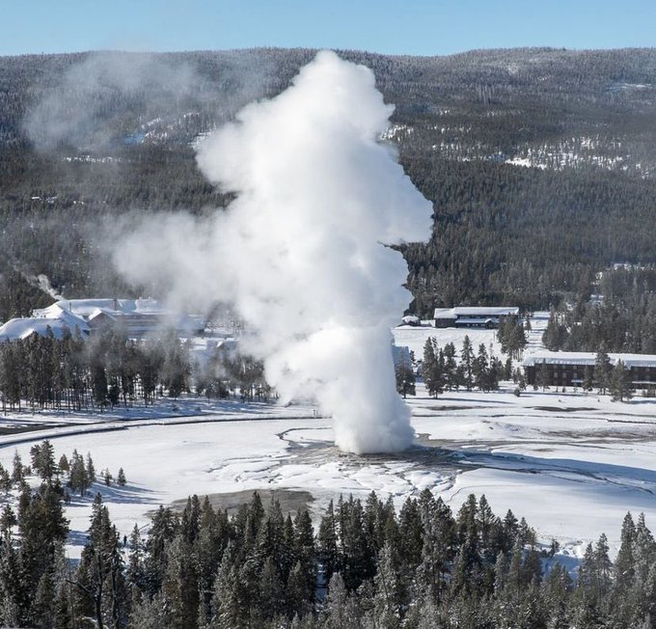
Interpretation
Heat output has not significantly changed over the last ten years
Fall/Winter dates hotter than Spring/Summer
From @yellowstonenps on Instagram
Notes:
future

Slide 8
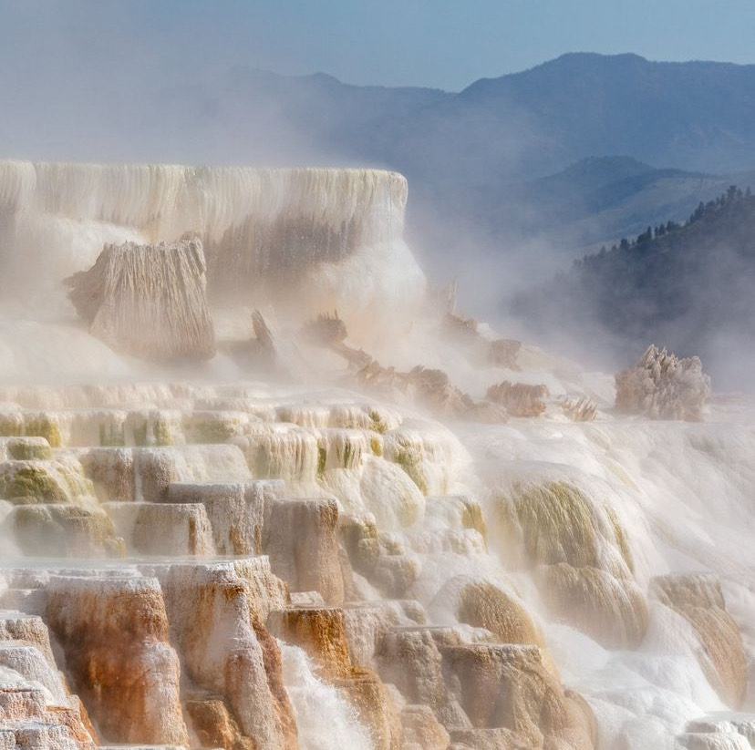
Acknowledgments
Special thanks to The Arizona Space Grant Consortium, NASA, the USGS, and Dr. Greg Vaughan for his mentorship.
From @yellowstonenps on Instagram

Slide 9

Thank you

